Slide 1
Statistical Analysis of Assets traded internationally using data science tools
-Parth gargava
-Jyotsna Khatter

Slide 2
Background
The project analyses trading statistics of goods across nations with tools like- PCA, Bayesian model, statistical hypothesis testing, ANOVA and feed forward neural network along with visualisations!

Slide 3
Data source
The United Nations Commodity Trade Statistics Database (UN Comtrade) complete trade records between countries and publishes it for free. We have fetched data from 1985 to 2016 which is ~1.2 Gb in size. Over 140 reporter countries provide the United Nations Statistics Division with their annual international trade statistics detailed by commodities and partner countries.
Our data is ranged from 1988 to 2016
Data URL: http://data.un.org/Explorer.aspx

Slide 4
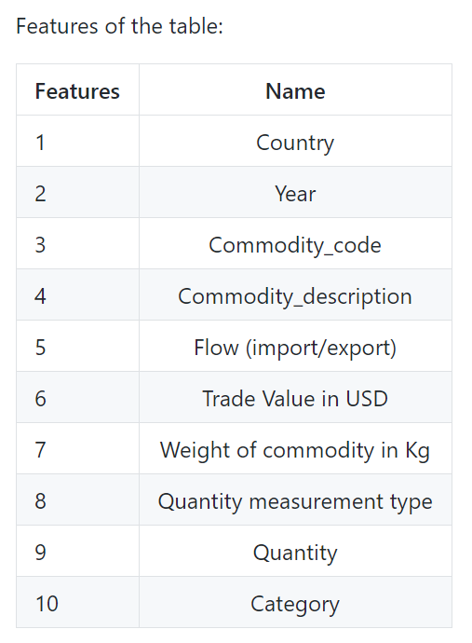
Features of dataset:

Slide 5
Aim/Motivation
The aim/acceptance criteria for the project was to successfully analyse international assets data to give meaningful insights and also test models like- Feed-forward neural network, ANOVA, PCA, Bayesian Model and statistical hypothesis testing.

Slide 6
Libraries used:
Pymc3
Keras
Numpy
Scipy
Matplotlib
Seaborn
Sklearn
plotly

Slide 7
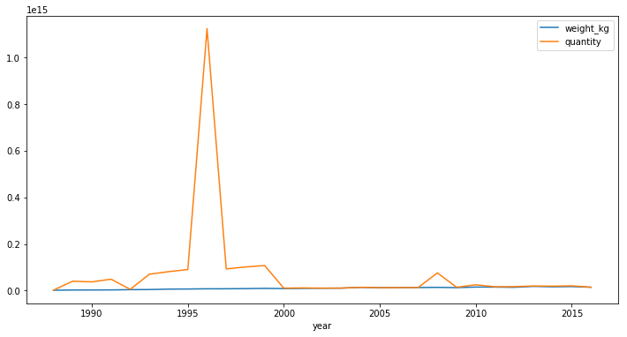
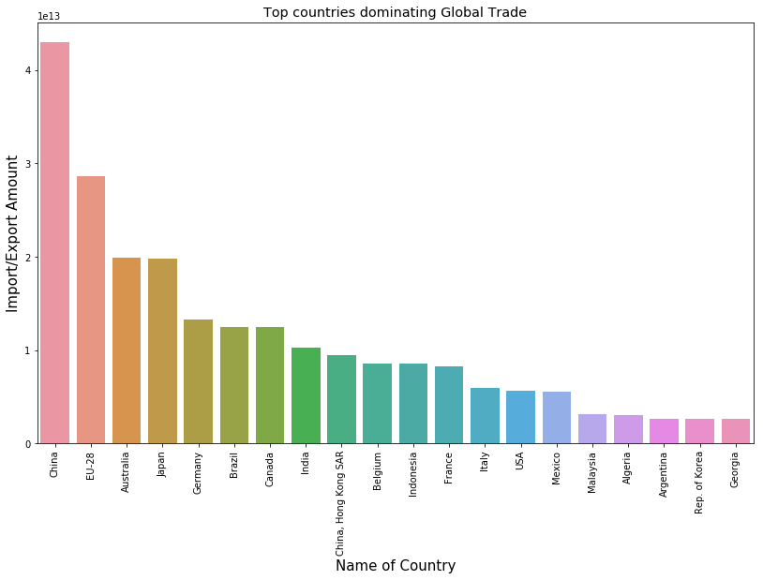
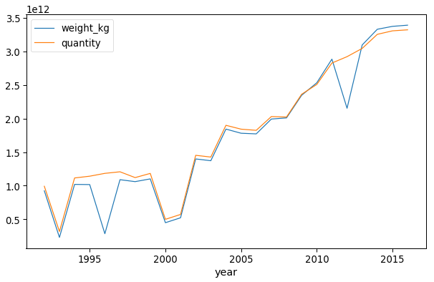
Some visualizations included in the notebook

Slide 8
Thank you! ☺

